Slide 1


AGE 316:
MICROCOMPUTER SYSTEMS
LECTURE 12: TIMERS & NON-BLOCKING CODE
Dr. Kadeghe Fue
Department of Agricultural Engineering

Slide 2



Recap: Lecture 11
Functions: Modular blocks of code that perform specific tasks.
Libraries: Collections of functions (e.g., Servo.h).
Clean Code: Writing logic that is easy to read and debug.

Slide 3



The Problem with delay()
digitalWrite
HIGH
delay
// Wait 5 seconds
digitalWrite
LOW
Blocking Code
During delay(), the Arduino CANNOT:
•
Read a sensor.
delay() pauses the entire processor.
•
Detect a button press.
During that 5 seconds, the Arduino is "asleep".
•
Update a display.

Slide 4

Analogy: The Blocking Chef
Blocking (Delay)
Put a pizza in the oven for 15 minutes.
Stare at the oven for 15 minutes. Do absolutely nothing else.
Ignore the phone ringing. Ignore the fire alarm.
Inefficient!

Slide 5

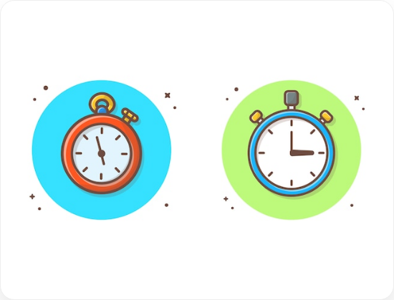
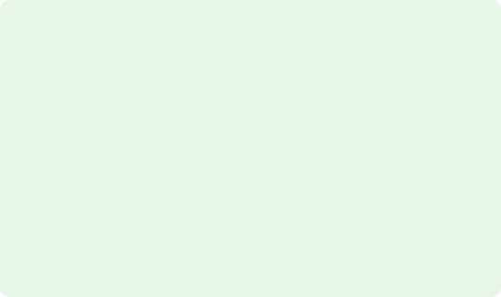
Analogy: The Multitasking Chef
Non-Blocking (Millis)
Put pizza in oven. Note the time.
Chop vegetables. Check phone. Wash dishes.
Periodically check: "Has 15 minutes passed yet?"
Efficient!

Slide 6







The Solution: millis()
millis() returns the number of milliseconds since the Arduino board began running.
It Never Stops
Read Only
Unsigned Long
It counts up continuously from 0 immediately after power on.
You cannot reset it. You can only read it.
It stores a huge number. We use unsigned long variables to hold it.

Slide 7

The Logic: "Are we there yet?"
Instead of pausing, we check the difference in time.
Start
Target
If the difference is small, we keep working. If the difference is big enough, we do the task.

Slide 8
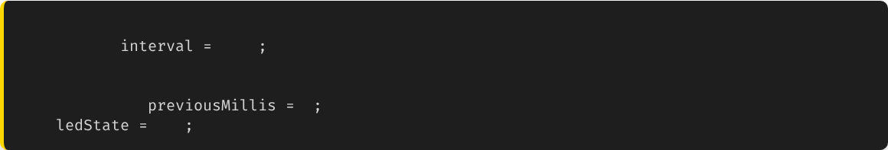
Step 1: Variables
To use this technique, we need to remember the last time we did something.
// Constants
const long
1000
// Blink every 1 sec
// State Variables
unsigned long
0
// Last time we blinked
int
LOW
Note: We use unsigned long because int is too small to hold the number of milliseconds the Arduino runs for (overflows in 32 seconds vs 50 days).

Slide 9

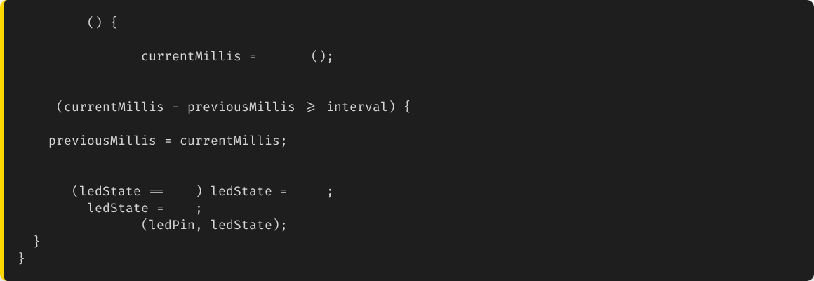
Step 2: The Loop Logic
void
loop
// 1. Check the time
unsigned long
millis
// 2. Compare
if
// 3. Save the new time!
// 4. Do the task
if
LOW
HIGH
else
LOW
digitalWrite

Slide 10

Why go through the trouble?
Multitasking!
Because the if statement only takes a microsecond to check, the processor is free the rest of the time.
Now you can:
•
Blink an LED while reading a button.
•
Update a screen while running a motor.

Slide 11

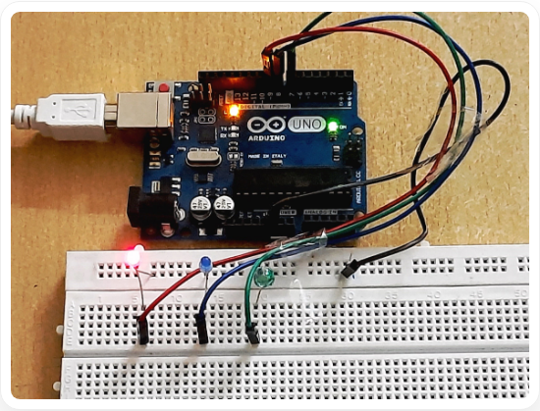
Example: Traffic Light System
Scenario
We want a traffic light to cycle (Red, Green, Yellow) automatically.
BUT we also want a pedestrian button. If pressed, it changes immediately.
With delay(10000) on Green, the button would be ignored for 10 seconds!
With millis(), the button works instantly.

Slide 12



Advanced: State Machines
Using millis() often leads to "State Machines".
State 1: IDLE
State 2: ACTIVE
State 3: COOLDOWN
Waiting for button.
Motor running (Timer Start).
Fan On (Timer Check).
We use a switch...case variable to track which state we are in.

Slide 13
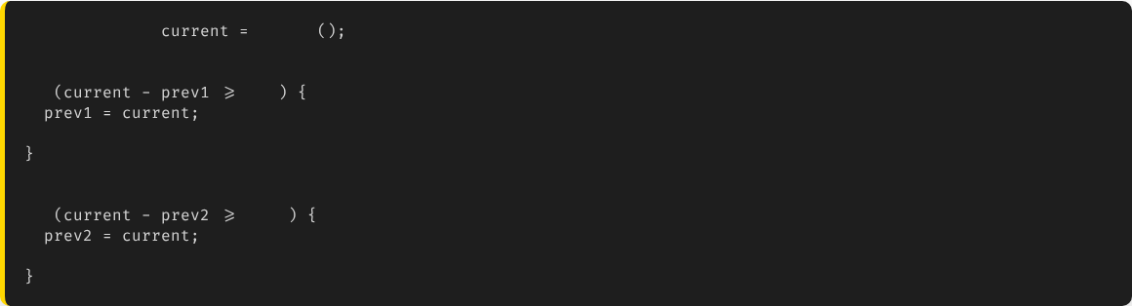
Multiple Timers
You can run many things at different speeds easily.
unsigned long
millis
// Timer 1: Fast Blink (LED 1)
if
200
// Toggle LED 1
// Timer 2: Slow Update (LCD)
if
1000
// Update LCD Screen

Slide 14

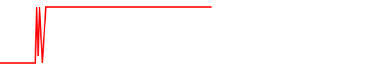
Concept: Debouncing
The Bouncing Signal
When you press a button, metal contacts vibrate. The Arduino sees: High-Low-High-Low-High in microseconds.
Software Debounce
We use millis()! We ignore any signal changes that happen within 50ms of the first press.
Noise

Slide 15





Teaser: Hardware Interrupts
Even millis() requires the loop to check repeatedly (Polling).
Interrupt
Use Case
A hardware signal that immediately pauses the loop, runs a quick function, and returns.
Emergency Stops, Precise Encoders.
(We will cover this in advanced lectures if time permits).

Slide 16





Summary
Delay is Bad
Millis is Good
Multitasking
It blocks the processor. Use it only for very simple demos.
Use millis() to track time without stopping the code.
By using non-blocking code, we can do multiple things "at once".

Slide 17


Questions?
"The only stupid question is the one you don't ask."
Dr. Kadeghe Fue
Sokoine University of Agriculture

Slide 18




Image Sources
https://www.healthyfood.com/wp-content/uploads/2021/11/How-to-multitask-like-a-chef-iStock-824283794.jpg
Source: www.healthyfood.com
https://img.freepik.com/premium-vector/stopwatch-vector-clipart-illustration-clock-timer-clipart-concept-white-isolated_138676-390.jpg
Source: www.freepik.com
https://projects.arduinocontent.cc/cover-images/8d220b4b-0833-4c7b-8eb7-abe3a8c45996.blob
Source: projecthub.arduino.cc

